Slide 1

Prepared by Team Phishing Group
Email Phishing Analysis and Detection

Slide 2
Team Members
Leader: Yousef Mohamed
Mohamed Hesham Elgeushy
Youmna Ramadan
Esraa Waleed
Merola Magdy

Slide 3
Introduction
Our project aims to analyze, identify, and implement effective techniques to detect and prevent email phishing attacks. We recognize the critical impact of phishing on cybersecurity and intend to explore advanced methods to enhance email security, protect sensitive information, and mitigate potential threats.

Slide 4
Background Project
Current scenario:
Email phishing has become one of the most prevalent and damaging cybersecurity threats in recent years. Cybercriminals use deceptive emails to trick users into revealing sensitive information such as login credentials, financial data, or personal details. Despite increased awareness and security measures, phishing attacks continue to evolve, becoming more sophisticated and harder to detect. Organizations face significant financial losses, data breaches, and reputational damage due to these attacks.
This project focuses on analyzing phishing email patterns, understanding the techniques used by attackers, and implementing detection methods to prevent potential threats. By leveraging advanced analytical and machine learning techniques, we aim to enhance email security and provide actionable strategies for phishing prevention.

Slide 5
Tools, Programming Language, and Platform
1. Tools Used:
Phishing Email Dataset: Collection of real and simulated phishing emails for analysis.
Email Analysis Tools: Tools like PhishTank, SpamAssassin, and MailTester for email verification and feature extraction.
Machine Learning Libraries: Libraries such as scikit-learn, pandas, NumPy, and TensorFlow for data processing and model building.
2. Programming Language:
Python – chosen for its versatility, extensive libraries for data analysis, and machine learning support.
3. Platform / Website:
file:///C:/Users/Mohamed%20Hesham/Desktop/DEPI_Proj/prj/Email_phishing.DEPI/ui/index.html
Jupyter Notebook – used for coding, visualization, and interactive analysis.

Slide 6



Project Objectives
│ User Interface Layer
API Service Layer
Core Analysis Engine
• Web-based Dashboard (HTML/CSS/JS)
• Real-time Risk Visualization
• Interactive Report Generation
FastAPI RESTful endpoints • Asynchronous file processing
• JSON response formatting
Email Parsing & Content Extraction
• Parallel Inspection Modules • Weighted Risk Scoring Algorithm
• Decision Making Logic

Slide 7
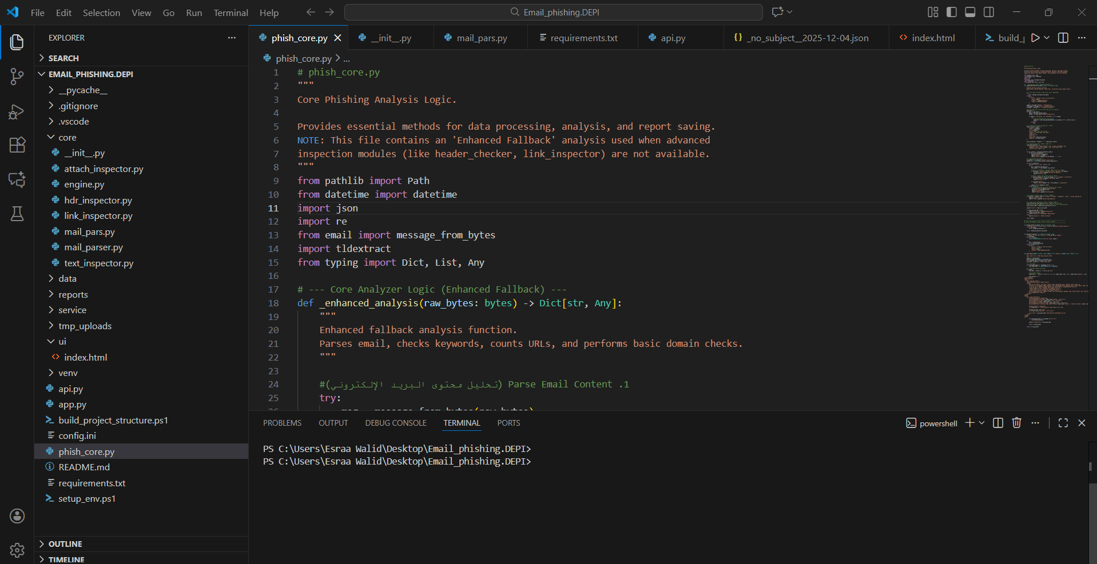
Backend Stack:

Slide 8
Python 3.8+
• FastAPI (Web framework)
• Email parsing library
• Regex for pattern matching
• TLDextract for domain analysis
Core Modules:
• mail_parser.py - Email structure parsing
• engine.py - Central coordination & scoring
• link_inspector.py - URL threat analysis
• hdr_inspector.py - Header authentication
• text_inspector.py - Content analysis
• attach_inspector.py - File safety checks

Slide 9
Methodology
Data Collection:
Gather phishing and legitimate email datasets from sources like PhishTank, SpamAssassin, and other publicly available datasets.
Data Preprocessing:
Clean and normalize email data (remove duplicates, irrelevant content, and standardize text).
Extract relevant features such as sender information, subject line, links, and content patterns.
Feature Engineering:
Identify key indicators of phishing emails (e.g., suspicious URLs, unusual sender addresses, misleading subjects).
Convert textual data into numerical representations suitable for machine learning models.

Slide 10
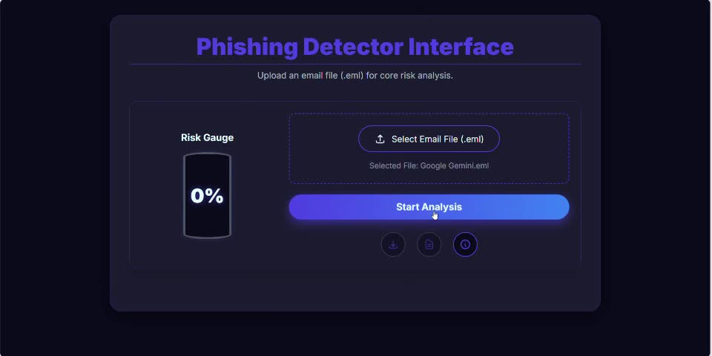
Simulation

Slide 11
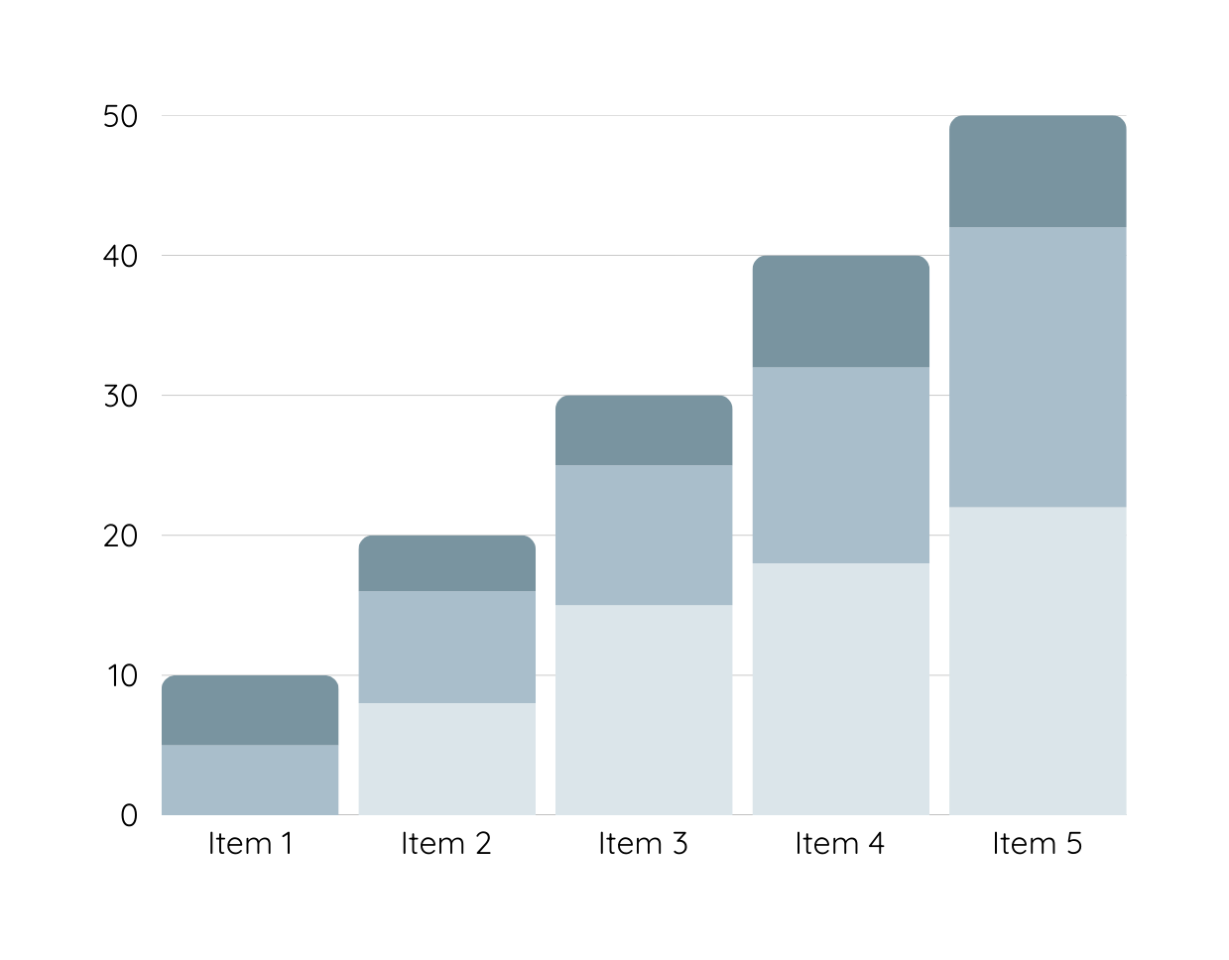
Risk Scoring Algorithm
Critical Issues (3 points each):
• SPF authentication failure
• DKIM signature failure
• DMARC policy failure
• Suspicious file attachments (.exe, .bat, .js)
Medium Issues (2 points each):
• Host is IP address in URL
• '@' symbol in URL
• Reply-To mismatch
• Many subdomains in URL
Minor Issues (1 point each):
• Suspicious keywords found
• Urgent language detected
• Basic URL anomalies

Slide 12
Conclusion
In this project, we analyzed the techniques used in email phishing attacks and implemented detection methods using machine learning. Our approach demonstrated that identifying key features and patterns in phishing emails can significantly improve detection accuracy. By leveraging Python, ML libraries, and reliable datasets such as PhishTank, we were able to develop a robust system to protect users from phishing threats.
This project highlights the importance of proactive email security measures and provides a foundation for further research and enhancement in phishing detection techniques. Effective implementation of such systems can reduce cyber risks, safeguard sensitive information, and enhance overall cybersecurity awareness.

Slide 13
Thank you

